Slide 1


West Trave University
Status_upd
9-25-25
A guide to cyber threats and online safety
Javier Napoles

Slide 2
Contents
About cybersecurity
Types of cyberattacks
What it is and why it matters
How attackers target people and systems
Cyberattack lifecycle
Staying safe online
The stages behind a typical cyberattack
Simple habits to protect your data

Slide 3

Would you click it?
Imagine you get an email from the university saying you’ve won a scholarship you never applied for.
All you have to do is “click the link below” to claim it. What would you do? What should you watch out for?
Share your answers with your peer.

Slide 4

What is cybersecurity?
Cybersecurity refers to the technologies and practices used to keep computer systems and electronic data safe.

Slide 5

Common types of cyberattacks
Cyberattacks are attempts to damage, disrupt, or gain unauthorized access to systems and data.
Types of cyberattack | Description
Phishing | Tricks users into revealing personal or sensitive info using fake links
Ransomware | Locks or encrypts data and demands payment to unlock it
Social engineering | Uses impersonation to manipulate people into sharing confidential info or access

Slide 6
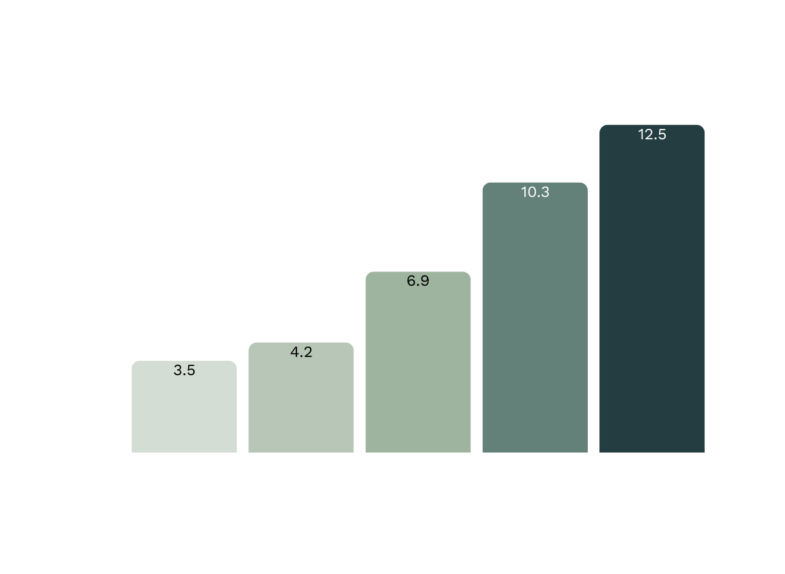
Worldwide reported cybercrime losses
In 2023, losses from cybercrime complaints reached $12.5 billion, which is more than triple the 2019 figure. The sharp rise began in 2021.

Slide 7
Lifecycle of a cyberattack
Cyberattacks usually follow these key stages:
Weaponization and Delivery
Reconnaissance
Exploitation
Gathering information
Creating and sending malicious tools
Using a system weakness to gain access
Actions on the objectives
Command and
Control
Installation
Stealing data or disrupting operations
Connecting to the system to issue instructions
Installing malware to gain control

Slide 8

You’ve used the same password for more than one account.
Digital safety check
You’ve clicked on a suspicious link.
Raise your hand if any of these apply to you.
You use public Wi-Fi without a VPN.
You store passwords in your notes app or send them to yourself.

Slide 9



Importance of cybersecurity
Protects sensitive data
Safeguards trust
Prevents theft or exposure of personal and business information
Maintains customer confidence and protects brand reputation

Slide 10
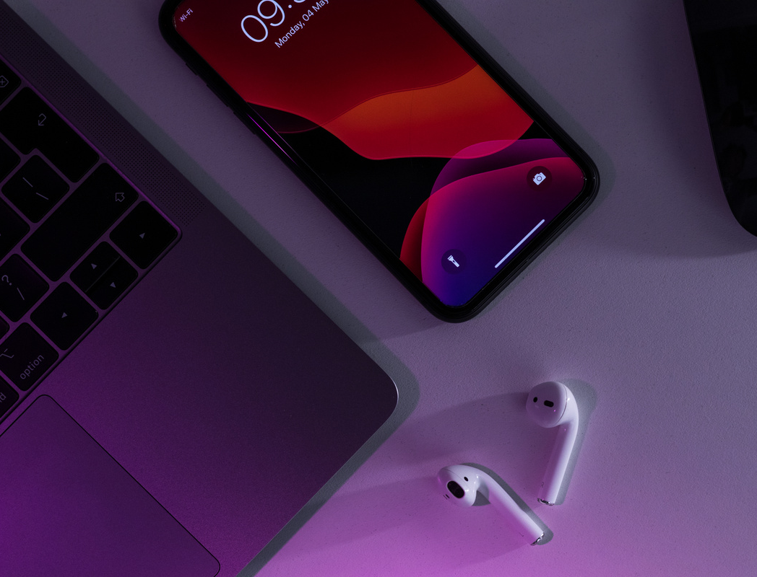
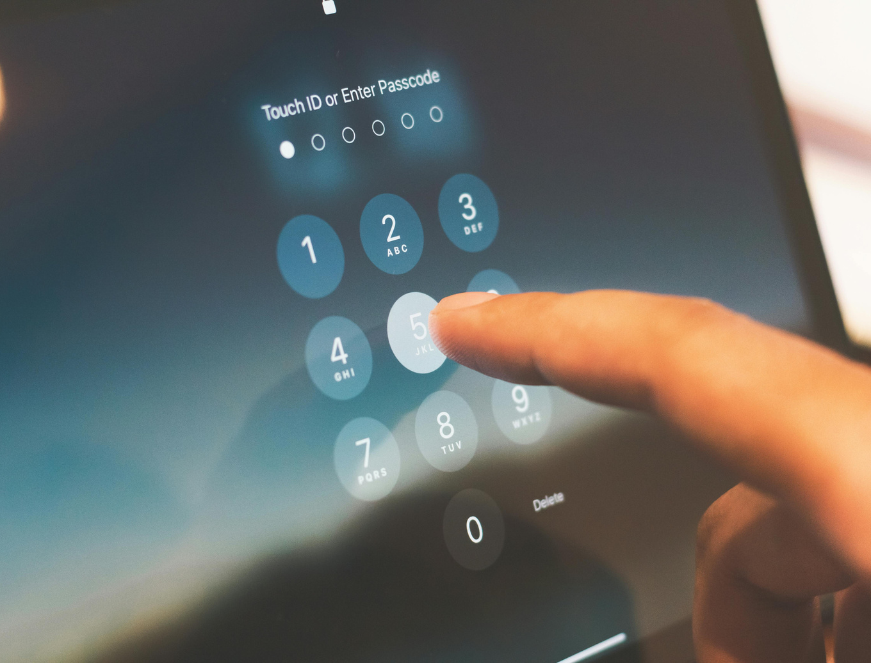

Cybersecurity best practices
Use strong, unique passwords
Think twice before
you click
Avoid reusing passwords. Use a password manager to create and store complex ones.
Avoid opening suspicious links
and attachments.
Enable two-factor authentication (2FA)
Add a second step to your login for extra protection.

Slide 11

Review
About cybersecurity
Involves protecting data, devices, and networks from digital threats.
Types of cyberattacks
Phishing, ransomware, and social engineering are tactics used to steal or damage data.
Cyberattack lifecycle
Cyberattacks follow key stages, from gathering information to execution and achieving the goal.
Staying safe online
Using strong passwords, enabling 2FA, and avoiding suspicious links can go a long way.

Slide 12

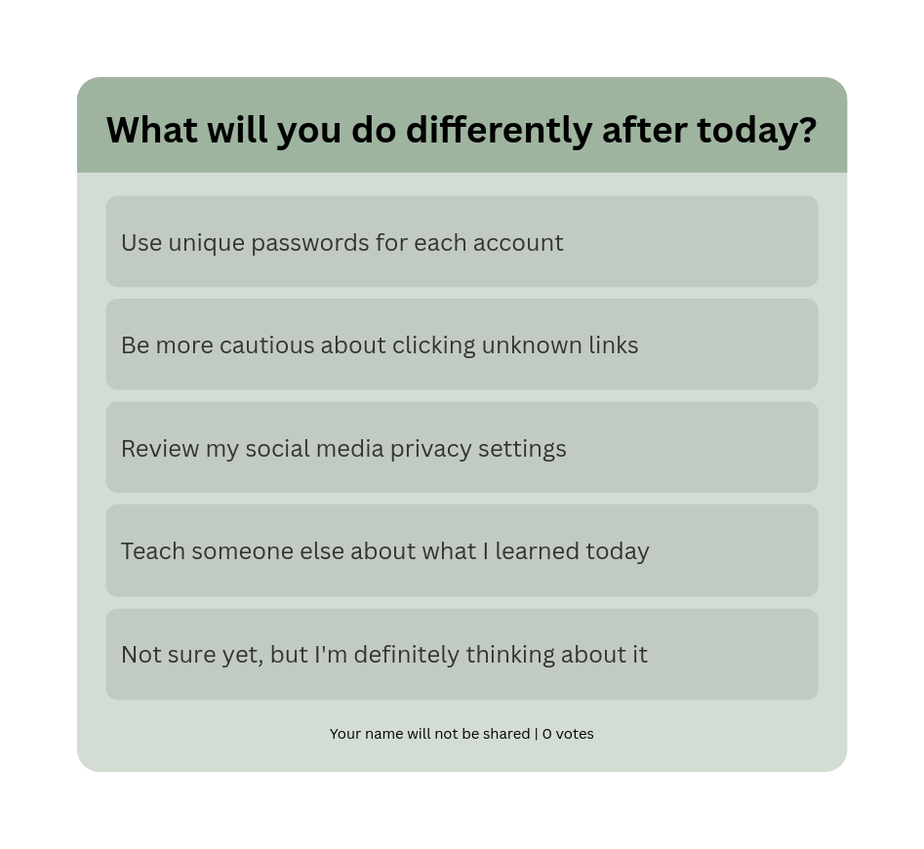
Putting it into practice
Select one habit you’re ready to start practicing today.

Slide 13

Resource Page
Use these in your presentation. Delete or hide this page before presenting.
Fonts
Design Elements / Icons
This presentation template
uses the following free fonts:
TITLES:
Glock Grotesk
BODY TEXT:
Work Sans
You can find these fonts online too.
Colors
#ED7843
#ED7843
#ED7843
#ED7843
#ED7843

Slide 14


Credits
for this presentation template
This presentation template is free for everyone to use, thanks to the following:
Pexels, Pixabay, Sketchify
for the photos, graphics, and elements

Slide 15
Resource Page
Find the magic in presenting. Select these keys while in Present mode. Delete or hide this page before presenting.
B for blur
C for confetti
D for a drumroll
M for a mic drop
Any number from
0-9 for a timer
O for bubbles
Q for quiet
U for unveil

